Slide 1
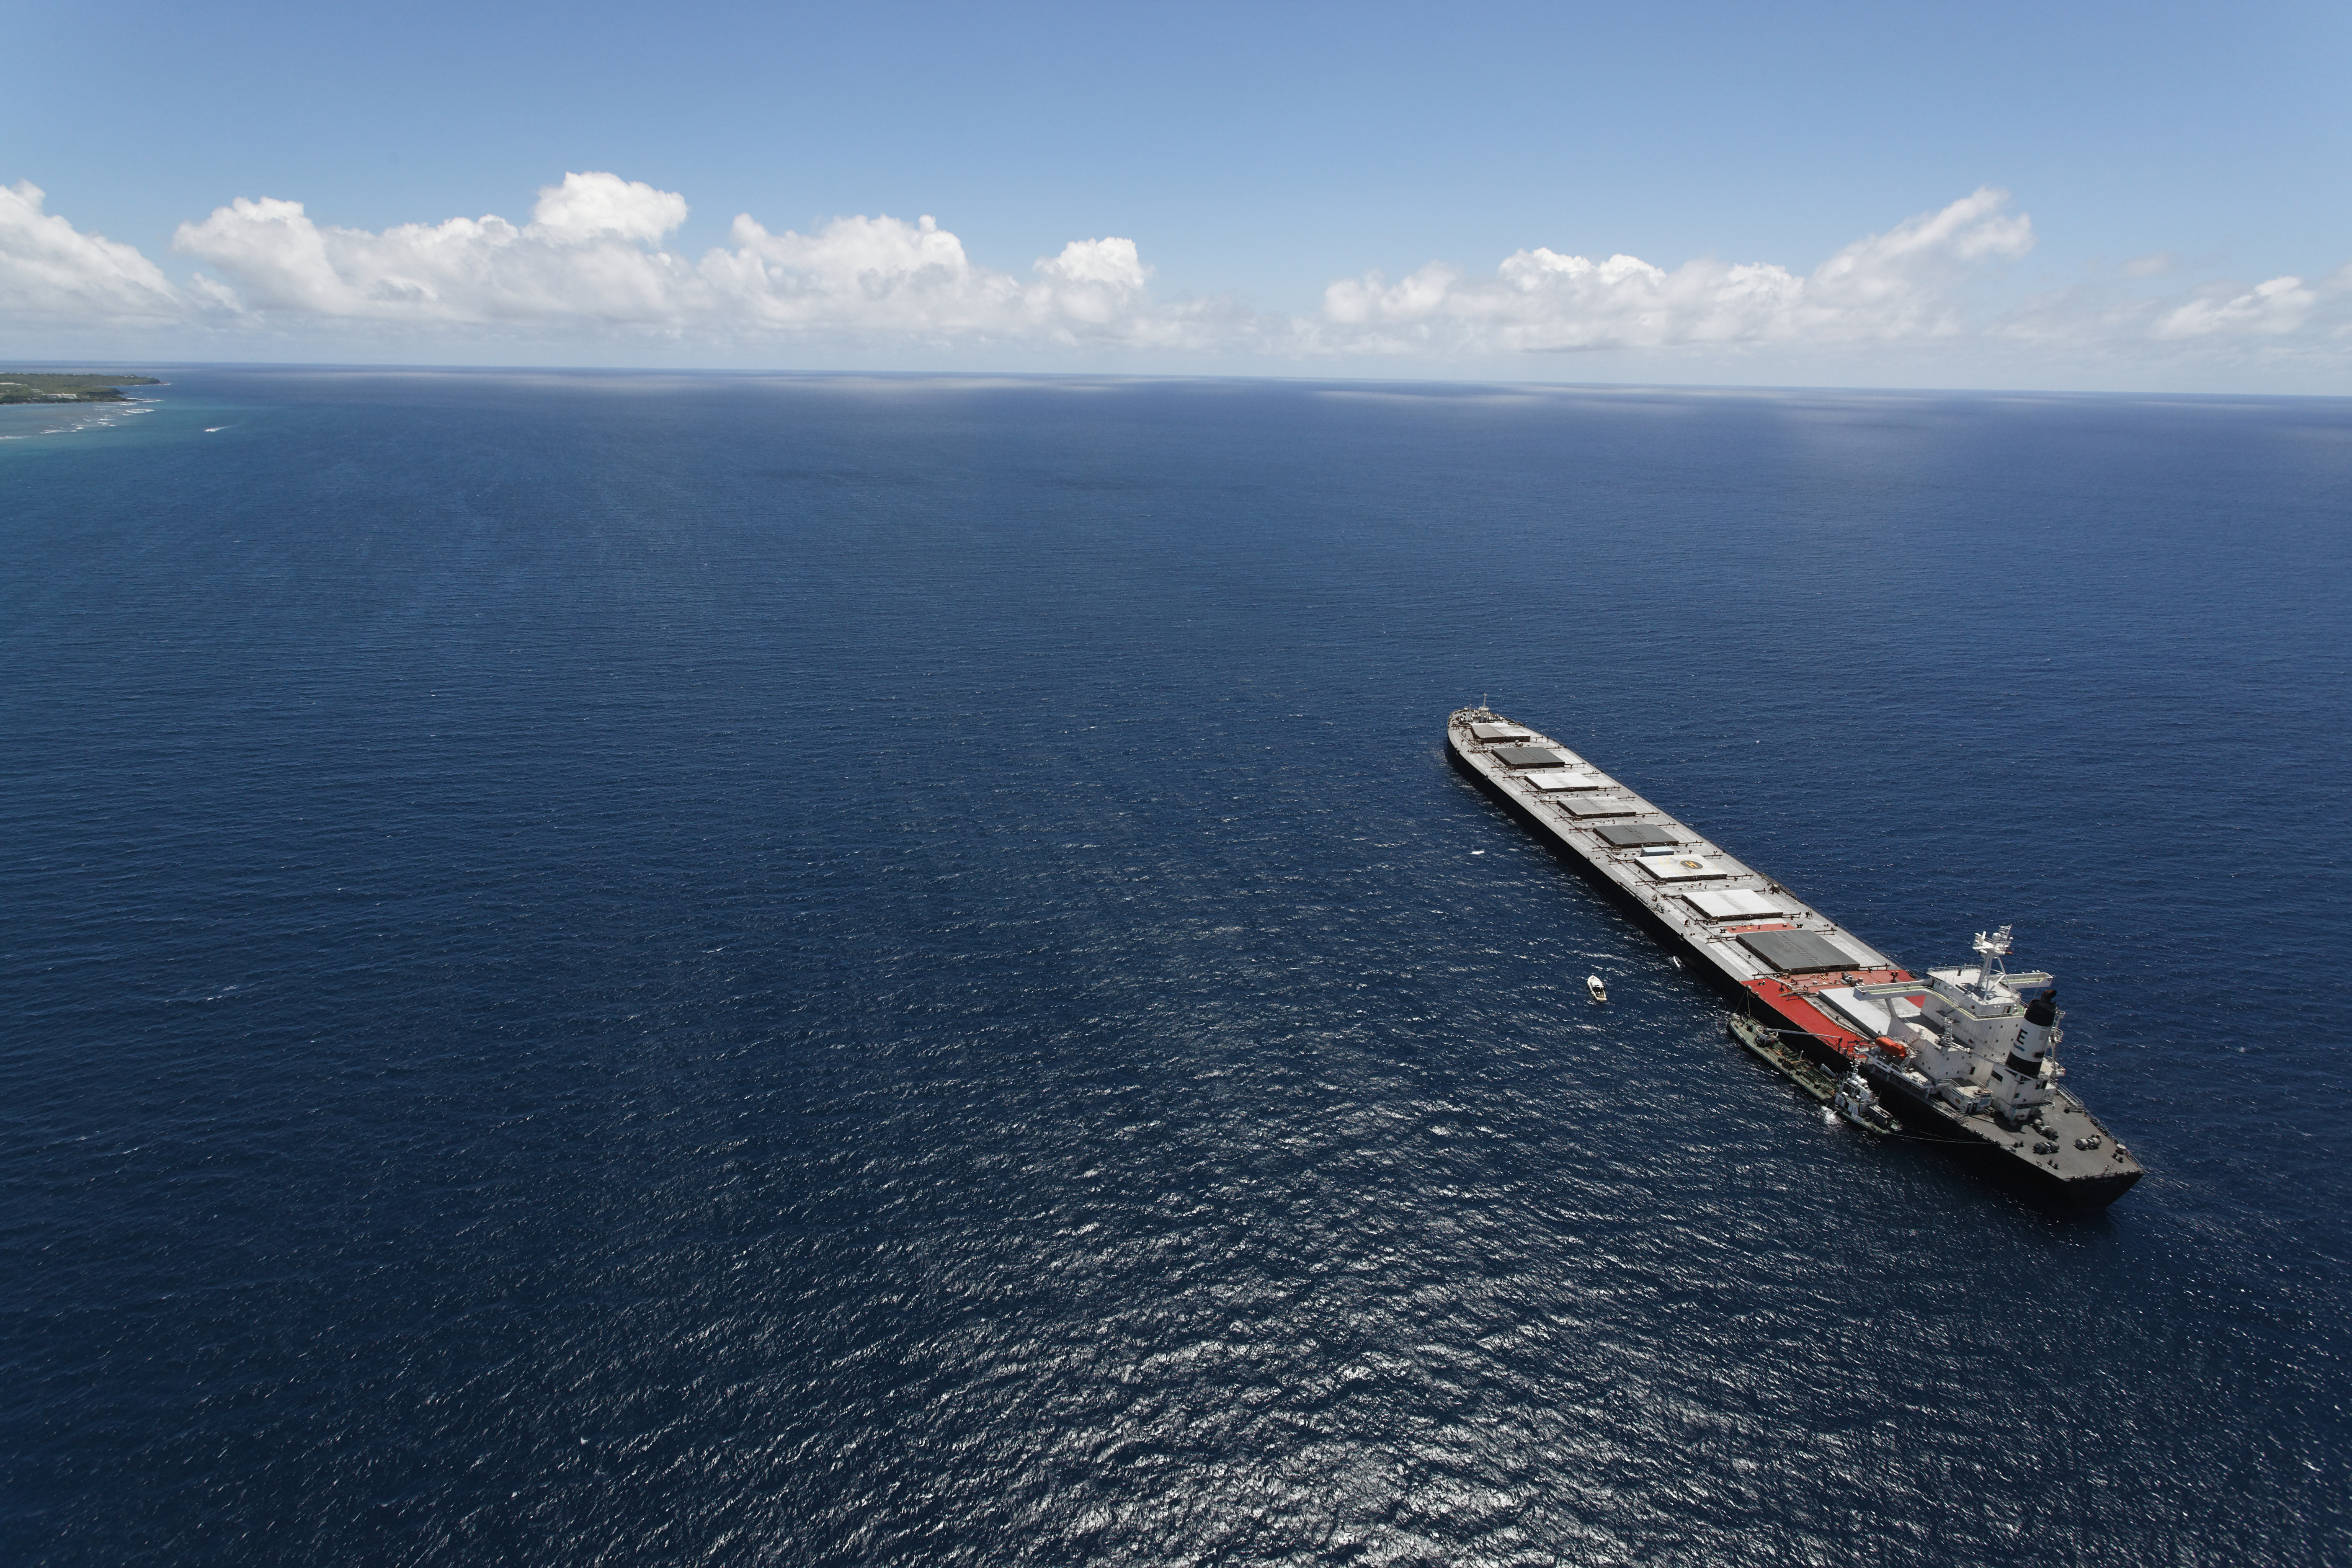
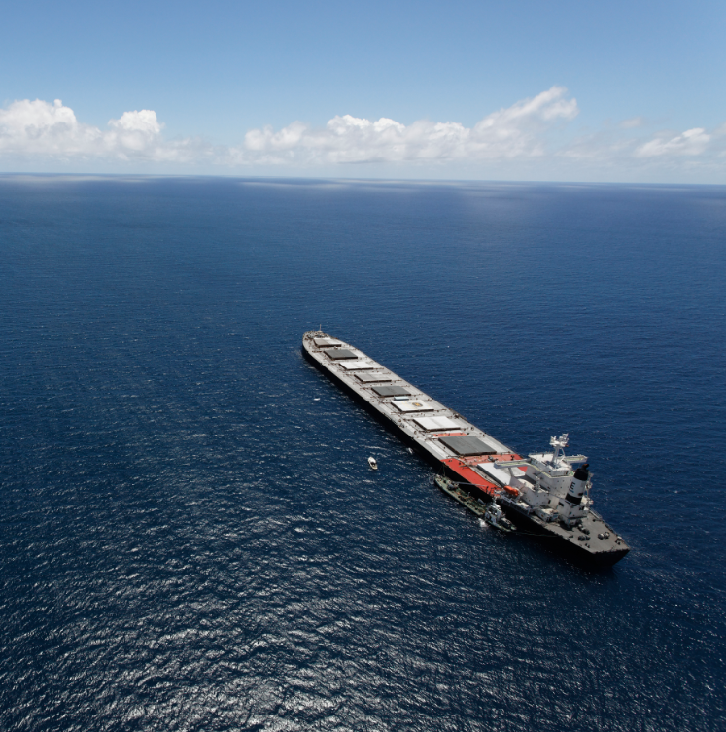
Fuel EU maritime & Imo Maria skipper Schwenn Director of environmental regulatory and public affairs

Slide 2
Bunker holding group in numbers
Enquiries
111,398
Nationalities
offices
66
53
Countries
ports
1,764
employees
1,500+
34

Slide 3
The hurricane of regulations
Recently implemented frameworks
Fleet/vessel emissions
Up-coming
EU ETS
Cap and trade of emission allowances
CO₂
FuelEU Maritime
Operational requirement on GHG intensity
CO₂
CII
Carbon intensity indicator rating
CO₂
EEXI
Energy efficiency requirement for existing ship index
IMO mid-term measures
Required GHG intensity of marine fuels & GHG emissions pricing mechanism (IMO to agree by 2025)
SEEMP III
Ship energy efficiency management plan

Slide 4
FUEL EU MARITIME
All ships above 5000 GT transporting passengers or cargo.
50% of energy use into or out of EEA, 100% of energy use between and within EEA ports.
Compliance can be banked, borrowed and pooled.
Mandatory 2% RFNBO* use from 2034. “Equivalent fuels with a similar or higher decarbonization potential” can be accepted.
Penalty: 2,400 EUR per tonne VLSFO energy equivalent or around 58,50 EUR per GJ non-compliant energy.
% reduction in GHG intensity
Legend
Fossil methanol
Higher than baseline
Reference (2020-average)
2%
6%
14.5%
LNG
Compliant until 2040
B30 VLSFO
31%
Reduction rate
62%
Bio-LNG, bio-methanol
Well-to-Wake Perspective, 2nd or 3rd gen.
80%
B100 (waste-based)
Green ammonia
2025
2030
2035
2040
2045
2050
*RFNBO: Renewable liquid and gaseous fuels of non-biological origin.
Notes:
FuelEU Maritime requires that ships gradually reduce greenhouse gas (GHG) emissions by cutting the amount of GHG in the energy they use (below 2020 level of 91.16 grams of CO2 per MJ) by 2% as of 2025, 6% as of 2030, 14,5% as of 2035, 31% as of 2040, 62% as of 2045 and 80% as of 2050. This would apply to ships above a gross tonnage of 5000, which are in principle responsible for 90% of CO2 emissions, and to all energy used on board in or between EU ports, as well as to 50% of energy used on voyages where the departure or arrival port is outside of the EU or in EU outermost regions.

Slide 5
well-to-wake PERSPECTIVE
WELL-TO-WAKE:
Refers to the emissions for the entire process from fuel production and delivery to use onboard ships
WELL-TO-TANK
TANK-TO-WAKE
Raw material
Fuel prodiction
Transportation
and storage
Bunkering
Storage on- board
Energy conversion
Energy transfer
to propeller
Notes:
How to present:
To be prepared

Slide 6
Upstream (well-to-tank) emissions matter
Well-to-Wake Emissions in Gram CO2eq. per kWh – GWP100
E-methanol
7
-99%
Legend
Legend
The way in which emissions from shipping are calculated is changing to reflect the full life cycle profile from production through to consumption on board.
This form of lifecycle assessment (known as well-to-wake) allows for a holistic approach to carbon assessment.
Whereas FUEM is WtW, ETS is only TtW.
WTT
Biodiesel (adv. fame)
0
-92%
WTT
TTW CO2
TTW CO2
-89%
TTW other GHG (CH4+NO2)
E-Ammonia
TTW other GHG (CH4+NO2)
%
Savings
BioLNG (organic waste)
12
-83%
%
Increase
BioMethanol
7
-65%
B30 (VLSFO and Biodiesel, adv. fame)
7
-27%
LPG
6
-17%
LNG
12
-16%
HFO w/ scrubber
10
-3%
MGO
9
VLSFO
10
1%
Methanol (from natural gas)
7
12%
Biodiesel (1 generation)
9
28%
Ammonia (from natural gas)
45%
Source: Lindstad/Smart Maritime, 2021, except biodiesel (adv. Fame) based on ISCC LCA methodology
CO2eq. change compared to MGO
Notes:
How to present:
To be prepared

Slide 7
FEUM vs. EU ETS
Exemptions:
Small islands < 200,000 residents;
PSO connections between island MS and another MS and between an island and the mainland of the same MS;
outermost regions;
transhipment ports;
ice class ships and ships navigating in ice.
Offshore vessels exempted for now but could be included when FEUM is revised.
Legal entity
DoC holder (ETS: the shipowner remains the ultimate responsible entity unless mandated (via contract) to a third party/ship manager)
Onshore Power Supply (OPS)
Container and passenger ships from 2030 (moored for more than 2 hours in a TEN-T port)
Enforcement
ETS: compliance linke to the ‘company’ ie. all vessels under the same sm/owner etc. – FEUM: compliance linked to the vessel highlighting the need for contractual arrangements with third party manager, new owner etc.

Slide 8
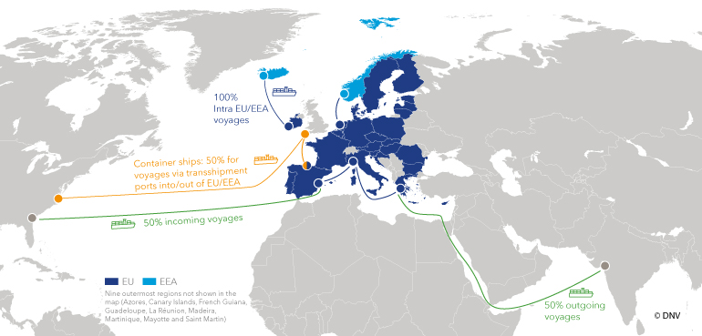
EU ETS and FuelEU maritime: regional scope
Both regulations cover 100% of emissions on voyages and port calls within the EU/EEA, and 50% of emissions on voyages into or out of the EU/EEA.
Port of call: A port where a ship stops to load/unload cargo or passengers.
To prevent evasive behaviour: Neighbouring container transshipment ports within 300nm from an EU port, where transshipment operations >65% of total traffic, will be included (50% of voyages, e.g., East Port Said and MedPort Tangier have already been included).
Source: DNV, EU ETS – Emissions Trading System

Slide 9
Incentivizing e-fuels
2025 2026 2027 2028 2029 2030 2031 2032 2033 2034 2035
Multiplier = 2 – Energy from RFNBOs counts twice
Check 1
Subtarget 2%
RFNBO in the Fuel Mix (reported in MRV) ≥ 1%
Commission shall monitor, calculate and publish annually, on the basis of the data recorded in the FuelEU database referred to in Article 19 and at the latest 18 months after the end of each reporting period, the share of RFNBO
No
Yes
No sub-target
No
Check 2
Yes
RFNBO in the Fuel Mix (reported in MRV) ≥ 2%
RFNBOs: RFNBO multiplier of 2 from 2025-2033 + if RFNBO shares in the maritime fuel mix is less than 1% in 2031 ➔ RFNBO sub-target of 2 % will kick in from 2034

Slide 10
Pooling borrowing Banking
Reward overachievers
Rapid deployment of new fuels
Across companies, but the same verifier
Open market

Slide 11
Pooling
Can be a real advantage

Slide 12
Banking & borrowing + penalty
Banking
Borrowing
Penalty
The company can “bank” the compliance surplus for the same vessel
No expiration date
In case of deficit, the company can borrow an advance compliance surplus from the next reporting period
But a multiplier of 1.1 is added to the compliance balance (more difficult to comply)
Cannot exceed 2% from baseline
Cannot be applied for two consecutive periods
2.400 EUR x non-compliant emissions in tonnes VLSFO-eq
Based on the actual GHG intensity of the vessel
Progressively increased in case of compliance deficit for two or more consequtive periods.

Slide 13
Compliance Timeline

Slide 14
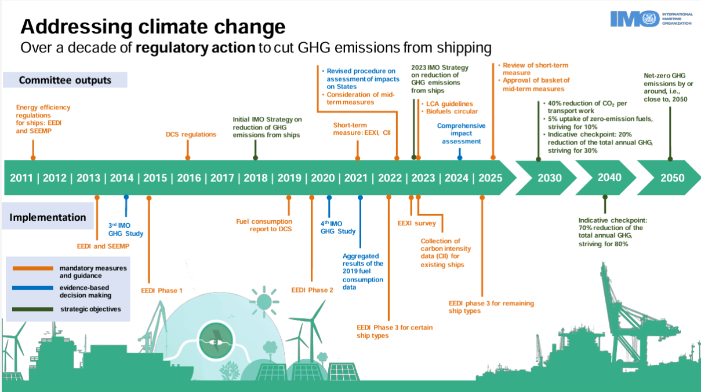

Slide 15
revised Imo ghg strategy
Absolute GHG emissions reach net-zero by or around 2050
Absolute: 20% reduction
(striving for 30%)
Intensity: 40% reduction
Zero or near-zero carbon energy share: 5% (striving for 10%)
Absolute: 70% reduction (striving for 80%)
Baseline year 2008
Emissions pathway in line with IMO’s revised GHG strategy
Peak as soon as possible
Business-as-usual emissions
Emission gap
2008
2020
2030
2040
2050
Notes:
IMO MEPC 80 meeting in July 2023 – redefining the IMO’s ambitions to 2050 with an ”increased level of ambition”.
Total GHG emissions from shipping to reach net-zero by and around 2050. Taking into account different national circumstances.
Indicative check-points of total shipping GHG emssions being reduced by at least 20%, striving for 30%, from 2008’s levels by 2030, and by at least 70%, striving for 80%, by 2040.
The strategy sets an ambition for uptake of zero- or near-zero-GHG emission technologies, fuels or energy sources to reach at least 5%, striving for 10%, of total energy demand from international shipping by 2030.
The IMO’s initial GHG strategy, set in 2018, envisaged a cut of at least 40% in carbon emissions per transport work from 2008s levels by 2030. This target on carbon intensity remains unchanged in the revised strategy.
IMO has set a deadline of 2025 to agree a basket of mid-term measures to support the GHG strategy. This should include both a goal-based marine fuel standard regulating a phased reduction in the GHG intensity of marine fuels, and a GHG emissions pricing mechanism for shipping. These measures will take into account the full well-to-awke GHG emissions of marine fuels. The earliest point at which these measures could then come into force would be in 2027.

Slide 16
IMO
State of play
Global Fuel Intensity target/Global Fuel Standard + an economic measure
Two core proposals for GFI
Economic measure
Scope: WtW or TtW with categorisation on WtT and sustainability criteria
Flexibility provisions?
Integrated and / or separate economic instrument?
Significant divide between countries
“Europe +” – necessary supplemental mechanism
A number of Pacific SIDS / Caribbean islands – essential primary mechanism
A number of developing countries – totally unacceptable tax on trade
MEPC 82 in October will need to resolve key political differences

Slide 17
Conclusion
Game changing regulation
No ship can operate BAU
Focus on contractual relationship with DoC holder, verifier etc.
Preparation is key!
IMO will follow with similar measures
It’s a question of levels of ambition

Slide 18
Thank You

Slide 19
Mid-term measures
ECONOMIC MEASURE
TECHNICAL MEASURE – Global Fuel Standard (GFS)/Global Fuel Intensity (GFI) target
GHG fuel intensity (GFI) target, which could be either on a tank-to-wake basis combined with sustainability criteria or on a full well-to-wake basis.
No flexibility, creating a completely level playing field, or the inclusion of flexibility elements such as route or cargo exemptions.
A potential pricing mechanism which either takes the form of a feebate or levy.
Revenue disbursement areas, which could include R&D, adaptation efforts, mitigating disproportionately negative impacts (DNI) and/or capacity building.

Slide 20
EU ETS: vessel scope
EU ETS initially covers cargo and passenger vessels sized 5000GT+, and is phased in during the first 3 years.
Shipping companies are already required to report emissions annually under the EU MRV regulation. This data is used to determine the allowances they need to surrender.
 | COMPLIANCE SCHEME | 2023 | 2024 | 2025 | 2026 | 2027 | 2028 | 2029 and onwards
TYPE OF VESSEL | ETS | N/A | Cargo & Passengers |  |  | Cargo, Passengers & Offshore Vessels
 | MRV | Cargo & Passengers |  | Cargo, Passengers & Offshore Vessels
SIZE OF VESSEL | ETS | N/A | >5000GT |  | >400GT and Offshore 1) | >400GT and Offshore 1)
 | MRV | >5000GT |  | >400GT (General Cargo and Offshore vessels)
GEOGRFICAL SCOPE | ETS | N/A | 100% intra EU/EEA, 50% in&out EU/EEA
 | MRV | 100% intra EU/EEA, 50% in&out EU/EEA |  |  |  |  |  | 100% intra / in&out EU/EEA 2)
PHASE-IN TIMELINE | ETS | N/A | 40% | 70% | 100%
 | MRV | 100%
GHG SCOPE | ETS | N/A | CO2 | CO2, Methane(CH4) & Nitrous Oxide (N2O) | CO2, Methane(CH4) & Nitrous Oxide (N2O)
 | MRV | CO2 | CO2, Methane (CH4) & Nitrous Oxide (N2O)
1) To be discussed in 2026 2) to be decided in EU review before 2028
Notes:
So what is the role of Carbon Markets

